Slide 1




PIZZA SALES SQL QUERIES
1.TOTAL REVENUE:
SELECT SUM(TOTAL_PRICE) AS TOTAL_REVENUE FROM [pizza sales csv file];
OUTPUT:
2.AVG ORDER VALUE:
SELECT SUM(TOTAL_PRICE)/COUNT(DISTINCT ORDER_ID) AS AVG_ORDER_VALUE FROM [pizza sales csv file];
OUTPUT:
3.TOTAL PIZZA SOLD:
SELECT SUM(QUANTITY) AS TOTAL_PIZZA_SOLD FROM [pizza sales csv file];
HERE
OUTPUT:
4.TOTAL ORDERS:
SELECT COUNT(DISTINCT ORDER_ID) AS TOTAL_ORDERS FROM [pizza sales csv file];
OUTPUT:

Slide 2

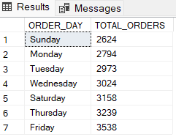
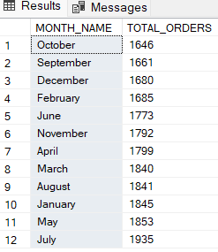
5.AVG PIZZAS PER ORDER: SELECT SUM(QUANTITY)/COUNT(DISTINCT ORDER_ID) AS AVG_PIZZA_PER_ORDER FROM [pizza sales csv file];
OUTPUT:
OUTPUT:
6.DAILY TREND FOR TOTAL ORDETS:
SELECT DATENAME(DW, ORDER_DATE) AS ORDER_DAY,COUNT(DISTINCT ORDER_ID) AS TOTAL_ORDERS FROM [pizza sales csv file]
GROUP BY DATENAME(DW, ORDER_DATE) ORDER BY TOTAL_ORDERS ASC;
OUTPUT:
7.MONTHLY TREND FOR TOTAL ORDERS:
SELECT DATENAME(MONTH,ORDER_DATE) AS MONTH_NAME, COUNT(DISTINCT ORDER_ID) AS TOTAL_ORDERS FROM [pizza sales csv file]
GROUP BY DATENAME(MONTH,ORDER_DATE) ORDER BY TOTAL_ORDERS ASC;

Slide 3
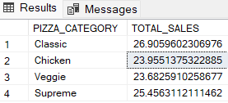
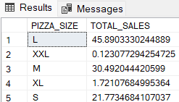
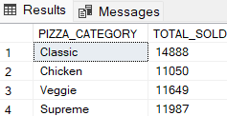
8.PERCENTAGE OF SALES BY PIZZA:
SELECT PIZZA_CATEGORY,SUM(TOTAL_PRICE) *100 / (SELECT SUM(TOTAL_PRICE) FROM [pizza sales csv file]) AS TOTAL_SALES
FROM [pizza sales csv file]
GROUP BY PIZZA_CATEGORY;
OUTPUT
9.PERCENTAGE OF SALES BY PIZZA SIZE:
SELECT PIZZA_SIZE,SUM(TOTAL_PRICE) * 100/(SELECT SUM(TOTAL_PRICE) FROM [pizza sales csv file]) AS TOTAL_SALES
FROM [pizza sales csv file]
GROUP BY PIZZA_SIZE;
OUTPUT
OUTPUT
10.TOTAL PIZZAS SOLD BY PIZZA CATEGORY:
SELECT PIZZA_CATEGORY,SUM(QUANTITY) AS TOTAL_SOLD FROM [pizza sales csv file]
GROUP BY PIZZA_CATEGORY;

Slide 4
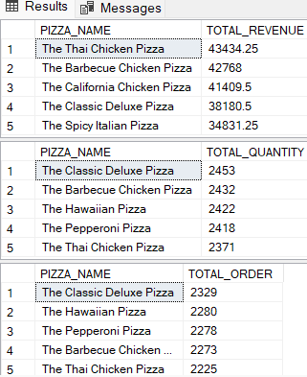
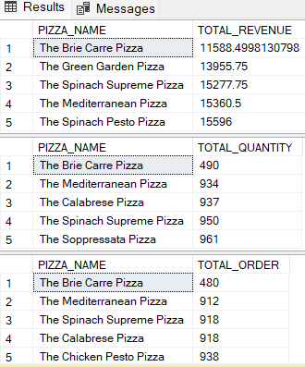
11.TOP 5 BEST SELLERS BY REVENUE,TOTAL QUANTITY AND TOTAL ORDERS:
SELECT TOP 5 PIZZA_NAME , SUM(TOTAL_PRICE) AS TOTAL_REVENUE FROM [pizza sales csv file]
GROUP BY PIZZA_NAME ORDER BY TOTAL_REVENUE DESC
SELECT TOP 5 PIZZA_NAME , SUM(QUANTITY) AS TOTAL_QUANTITY FROM [pizza sales csv file]
GROUP BY PIZZA_NAME ORDER BY TOTAL_QUANTITY DESC
SELECT TOP 5 PIZZA_NAME , COUNT(DISTINCT ORDER_ID) AS TOTAL_ORDER FROM [pizza sales csv file]
GROUP BY PIZZA_NAME ORDER BY TOTAL_ORDER DESC
OUTPUT:
OUTPUT:
12.BOTTOM 5 SELLERS BY REVENUE,TOTAL QUANTITY AND TOTAL ORDERS:
SELECT TOP 5 PIZZA_NAME , SUM(TOTAL_PRICE) AS TOTAL_REVENUE FROM [pizza sales csv file]
GROUP BY PIZZA_NAME ORDER BY TOTAL_REVENUE ASC
SELECT TOP 5 PIZZA_NAME , SUM(QUANTITY) AS TOTAL_QUANTITY FROM [pizza sales csv file]
GROUP BY PIZZA_NAME ORDER BY TOTAL_QUANTITY ASC
SELECT TOP 5 PIZZA_NAME , COUNT(DISTINCT ORDER_ID) AS TOTAL_ORDER FROM [pizza sales csv file]
GROUP BY PIZZA_NAME ORDER BY TOTAL_ORDER ASC

